Slide 1
BMIN 5220 : NLP for Health
Purvansh Jain
Notes:
My project focuses on the application of Natural Language Processing, or NLP, in the healthcare sector. I will delve into how NLP can be used to analyze sentiments in drug reviews, providing valuable insights for healthcare providers and patients alike.

Slide 2
NLP-Based
Drug Review Sentiment Analysis
Sentiment Analysis of Drug Reviews: Unveiling User Opinions on Medications
Notes:
The essence of my project is sentiment analysis in the context of drug reviews. It's a fascinating area where I interpret emotions and opinions from text data. This analysis is crucial because it gives us a window into the real experiences of patients with medications, helping us understand their perspectives beyond clinical results.

Slide 3
Problem Statement
Understanding user sentiment in drug reviews poses a challenge due to the vast array of opinions, varied expressions, and nuanced language used. Extracting valuable insights from these diverse texts requires effective natural language processing techniques to decipher sentiment polarity accurately. Additionally, contextual understanding and disambiguation of phrases are pivotal to discerning true sentiments from potentially misleading or ambiguous expressions. Handling negations, sarcasm, and subjective language further complicates sentiment analysis, necessitating a robust methodology to categorize sentiments accurately amidst this intricate linguistic landscape.
Notes:
The challenge in sentiment analysis lies in the complexity of human language. Drug reviews are not just simple texts; they are rich with emotions, subjective opinions, and diverse expressions. My project aims to decipher these sentiments accurately using advanced NLP techniques. This is crucial in a field like healthcare, where understanding patient sentiment can directly impact treatment outcomes.

Slide 4
Objective
Develop Sentiment Analysis Model: Create an NLP model to analyze drug reviews sentiment accurately.
Accurate Polarity Identification: Enhance the system to detect nuances in sentiment polarity expressions.
Handle Linguistic Complexity: Implement methods to address sarcasm, negations, and subjective language intricacies.
Contextual Understanding: Improve algorithms for contextual comprehension of reviews for precise sentiment categorization.
Robustness and Scalability: Ensure the model's reliability and scalability across diverse datasets and review sources.
Notes:
Firstly, to develop a sophisticated NLP model capable of accurately analyzing sentiments in drug reviews. This includes detecting subtle nuances in how people express their feelings about medications. I also aimed to build a system that can handle the complexities of language, such as sarcasm, negations, and contextual nuances, ensuring My model's effectiveness across diverse linguistic scenarios.

Slide 5
Motivation:
Enhancing Medical Decision-Making: Understanding user sentiments aids in assessing drug efficacy and safety, benefiting healthcare decisions.
Improved User Experience: Identifying sentiments helps optimize drug choices, enhancing patient satisfaction and treatment adherence.
Informing Drug Development: Extracting sentiments provides valuable insights for pharmaceutical companies, guiding future drug innovations.
Notes:
The motivation behind this project is manifold. In the realm of healthcare, understanding patient sentiment can significantly enhance decision-making. It can lead to better patient
outcomes, inform pharmaceutical research, and ultimately, lead to more effective and patient_x0002_friendly healthcare services. By analyzing patient reviews, I can tap into a Ialth of unstructured data that holds the key to patient experiences and satisfaction.

Slide 6
Datasets
Dataset comprises 215,000 rows, split into 161,000 training and 53,800 testing rows.
Entries include fields like drug name, condition, review, rating, date, and an integer identifier.
Structured for drug reviews analysis, detailing drug efficacy, user experiences, and usefulness of reviews. (Data: https://huggingface.co/datasets/lewtun/drug-reviews)
Feature | Type | Description
Unnamed: 0 | int64 | Integer identifier for each entry
drug Name | string | Name of the drug
condition | string | Medical condition addressed by drug
review | string | User review text
rating | float64 | Numerical rating of the drug
date | string | Date of the review
useful Count | int64 | Count of users who found review useful
Notes:
For this project, I utilized a dataset that includes over 215,000 drug reviews. This vast dataset provided a rich foundation for My analysis, encompassing a wide range of medications, user demographics, and varied sentiments. The size and diversity of this dataset Ire instrumental in developing a robust sentiment analysis model.

Slide 7
Methods
Data Preprocessing: Tokenize text, handle sequences, and encode data for LSTM, BERT, and GRU.
Model Training: Train LSTM, BERT, and GRU models on drug review data for sentiment analysis.
Model Fusion/Ensemble: Combine predictions from LSTM, BERT, GRU, and Decision Tree models.
Evaluation Metrics: Assess performance using accuracy, F1 score, and confusion matrices for comparison.
Fine-tuning and Optimization: Refine models based on results, tuning hyperparameters for better performance.
Notes:
The implementation of My sentiment analysis project began with data preprocessing. First, I loaded My dataset, comprising over 215,000 drug reviews. My initial step was cleaning this data, which involved removing irrelevant information, handling missing values, and normalizing text. I employed natural language processing techniques to tokenize the reviews, remove stopwords, and stem or lemmatize the words.
After cleaning, I visualized the data to understand the distribution of sentiments and identify any patterns or outliers. This involved creating visual representations like word clouds to depict the most frequent words in the reviews and bar plots to show the distribution of ratings.
The next crucial step was feature engineering, where I transformed the cleaned text data into a format suitable for My machine learning models. I used techniques like TF-IDF vectorization to convert text into numerical vectors. This process is essential for My models tointerpret and learn from the text data.
I then split My dataset into training and testing sets, ensuring a balanced representation of sentiments in both. The training set was used to train My model, while the testing set helped
us evaluate its performance.

Slide 8
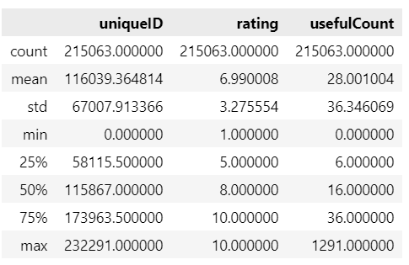
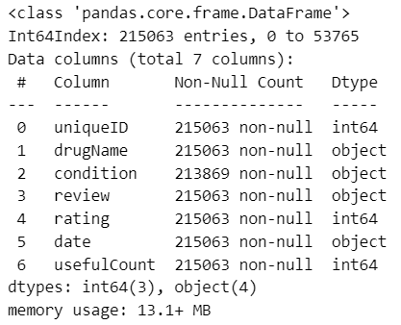
Implementation
Statistical Description
Information Reg Data
Notes:
For My model, I chose a Recurrent Neural Network with LSTM layers, ideal for dealing with sequence data like text. The bidirectional nature of My LSTM layers alloId the model to
understand context better from both directions of the sequence, leading to more accurate sentiment analysis.
The training process involved feeding the model with My preprocessed and vectorized text data, along with the corresponding sentiment labels. I monitored the model's performance
throughout the training phase, tIaking parameters as necessary to improve accuracy.
To prevent overfitting, I employed techniques like dropout layers within the neural network. These layers randomly deactivate certain neurons during training, forcing the model to
learn more robust features from the data.
Post-training, I evaluated My model's performance using the testing set. I used metrics like accuracy, precision, recall, and the F1-score to measure the effectiveness of My model in
correctly identifying sentiments.

Slide 9
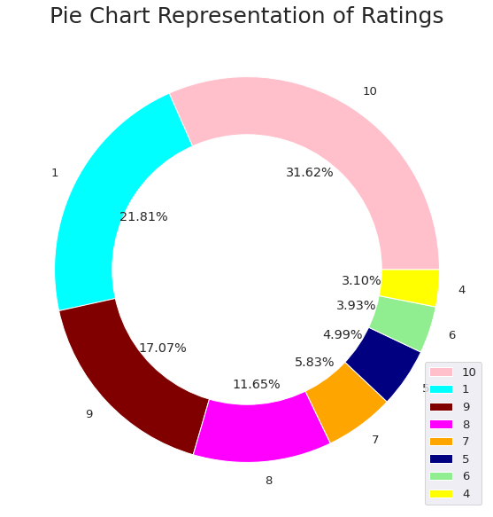
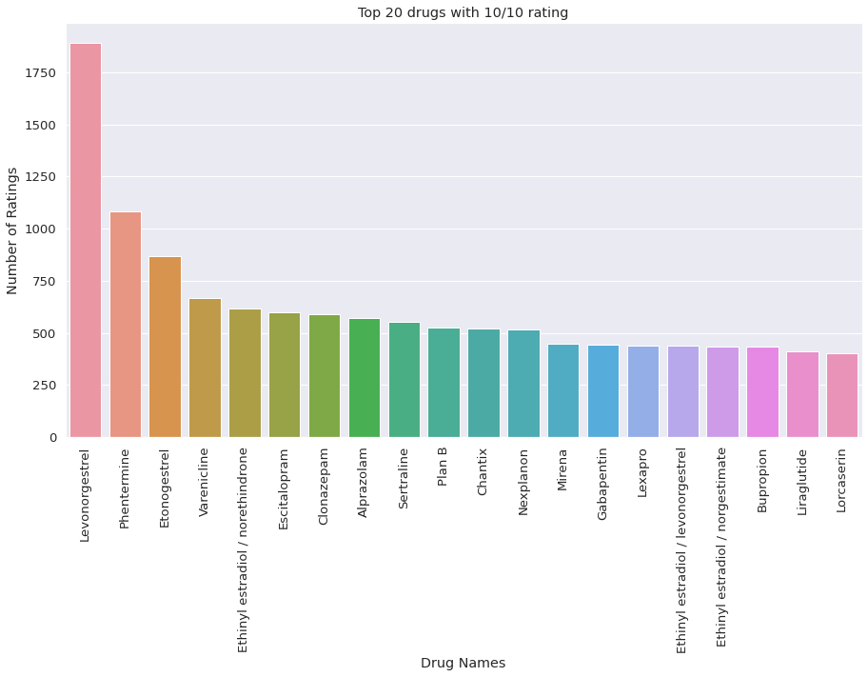
Implementation
Top 20 Drugs with 10/10 rating
Rating Presentation

Slide 10
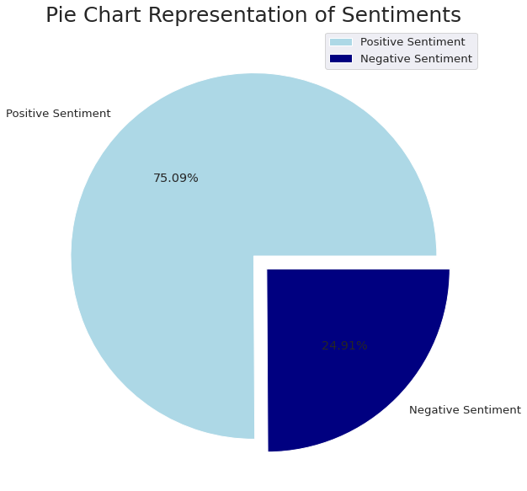
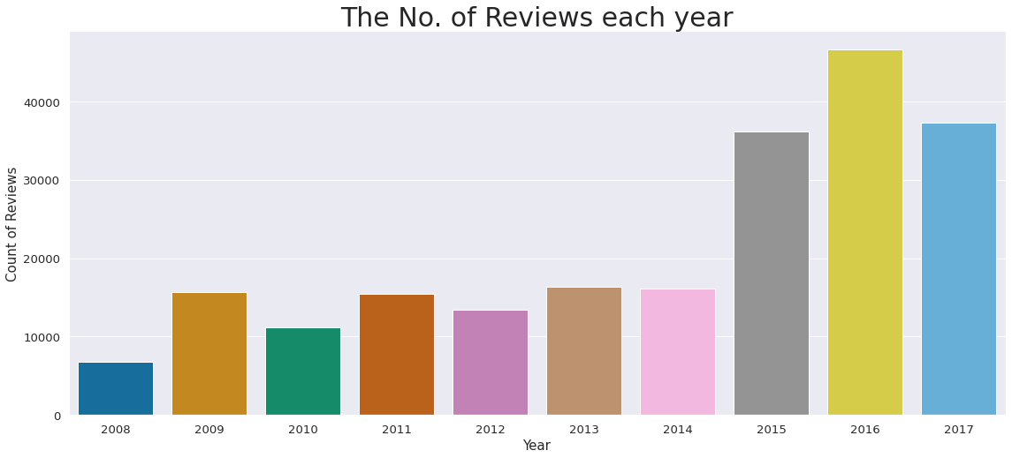
Implementation

Slide 11
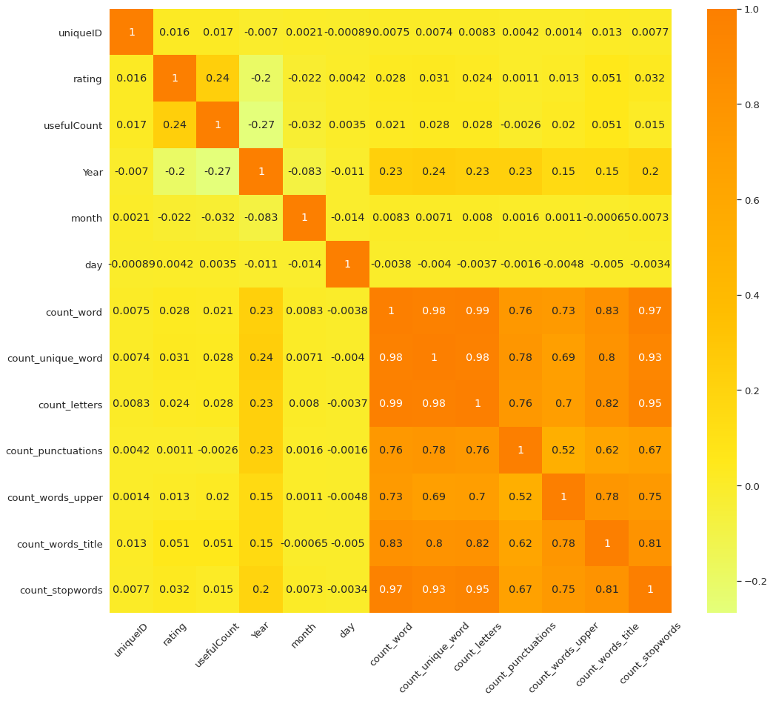
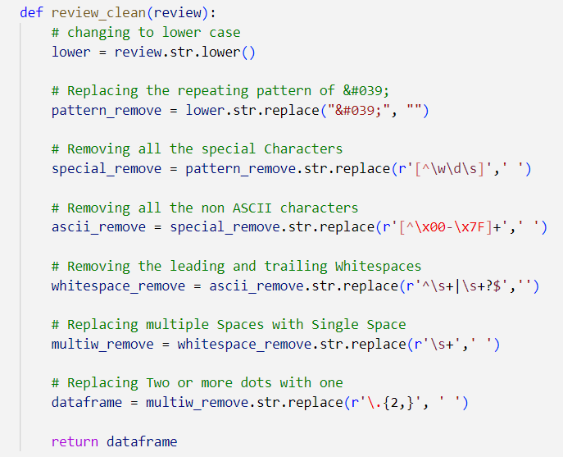
Implementation
Function to clean the text data
Heatmap: Represents Correlation

Slide 12
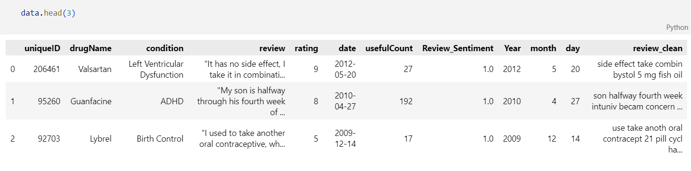
Implementation
Data After cleaning
z
This column has the cleaned reviews

Slide 13
Implementation
Data After cleaning
z
This column has the cleaned reviews

Slide 14
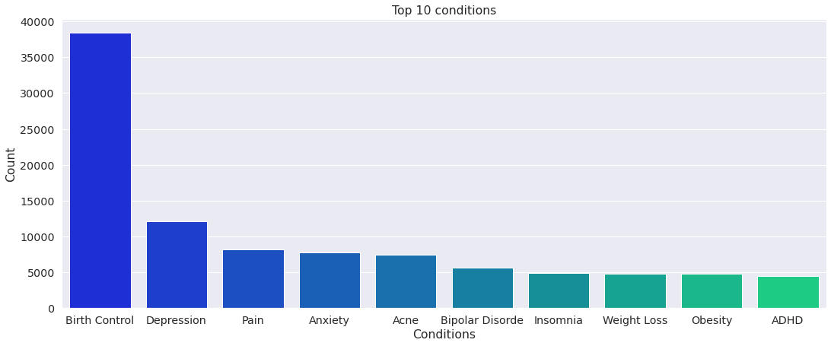
Implementation
Bar graph: Top 10 prevalent health conditions.
'Birth Control': Most frequent condition by far.
Followed by 'Depression' and 'Pain.'
Graph highlights prevalent health issues.
'Birth Control’ is notably predominant among conditions.

Slide 15
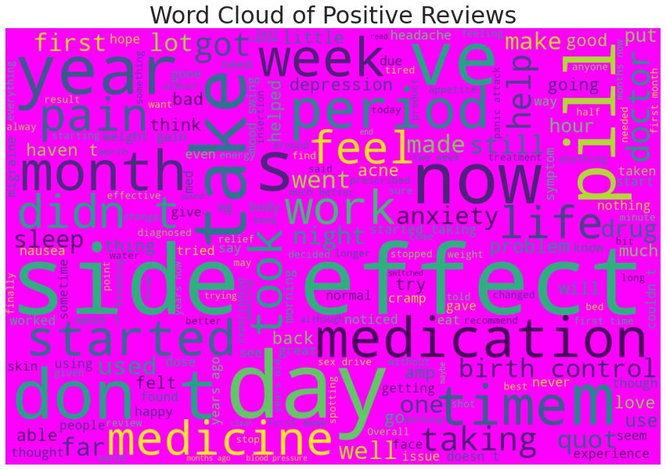
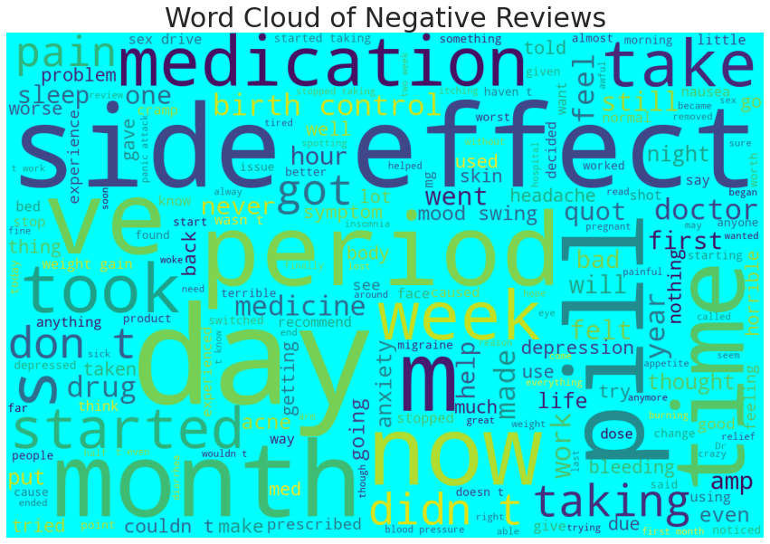
Implementation

Slide 16
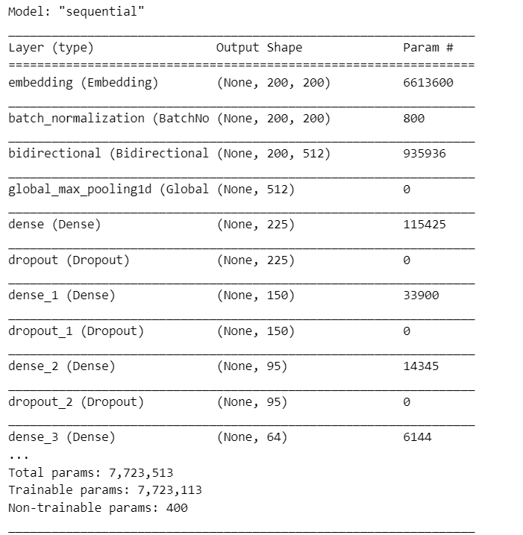
Implementation
Sequential model architecture overview.
Embedding layer: Input sequence transformed into vectors.
Batch normalization layer: Standardizes input for each batch.
Bidirectional layer: Captures bidirectional context within sequences.
Global max pooling: Extracts maximum value across sequence.
Multiple dense layers: Sequentially connected densely connected neural layers.
Dropout layers: Prevents overfitting by deactivating neurons randomly.
LSTM Architecture

Slide 17
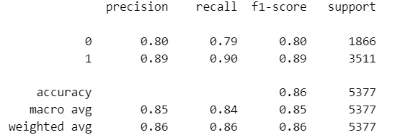
Implementation
Accuracy: Model's correct prediction percentage, approximately 86%.
Confusion matrix: Shows true/false positives/negatives.
Precision: Accuracy of positive class predictions.
Recall: Fraction of actual positives predicted correctly.
F1-score: Harmonic mean of precision and recall.
Support: Number of occurrences for each class.
Macro and weighted averages: Overall evaluation metrics.
Classification Report

Slide 18
Future Implications,Challenges & Limitations
Future Implications
Challenges
Refine healthcare insights through nuanced sentiment analysis.
Enable tailored treatments based on sentiment patterns.
Revolutionize pharmacovigilance with AI-driven real-time monitoring.
Extend sentiment analysis impact across diverse industries.
Decipher sarcasm, context, and evolving language nuances.
Ambiguities challenge precise sentiment classification in varied reviews.
Overcome biases inherent in user-generated sentiment.
Adapt models for regional dialects and cultural nuances.
Notes:
Looking towards the future, this project has the potential to significantly influence patient-centered care. By continuously refining My sentiment analysis techniques, I can provide even more accurate insights into patient opinions. HoIver, challenges remain, such as addressing biases in user-generated content and the evolving nature of language. Additionally, limitations like the representativeness of My dataset and the need for continuous updates to the model to adapt to new linguistic trends are important considerations for future work.

Slide 19
Future Implications,Challenges & Limitations
Limitation
Reviews lack crucial context for accurate sentiment interpretation.
Biases hinder objectivity in sentiment analysis models.
Subjectivity and absence of standardized rating systems pose challenges.
Interpretational complexities limit accurate sentiment analysis.

Slide 20
Conclusion
Model performance: Achieves commendable sentiment discernment with 86% accuracy in categorizing sentiments.
Confusion matrix: Shows balanced identification, notable true positives, and negatives for sentiment classification.
Precision and recall: Slightly higher for positive sentiment, indicating stronger predictive ability.
F1-score: Weighted average of 0.86 signifies balanced capture of sentiments.
Reliable generalization: Demonstrates consistent predictive ability across the dataset for sentiment analysis.
Improvement potential: Precision and recall enhancement needed for negative sentiments for balance.
Foundation for insights: Offers valuable sentiment understanding, aids pharmaceutical research, and healthcare decisions.
Notes:
In conclusion, My project represents a significant advancement in applying NLP techniques to healthcare. By analyzing sentiments in drug reviews, I offer new perspectives on patient experiences, contributing to more informed healthcare practices. I hope this presentation has given you valuable insights into the potential of NLP in healthcare.

Slide 21


